Slide 1
Asteroid occultation timing at randolph college
Hart Gillespie
Advisors: Jack Gross, Dr. Katrin Schenk
Funded by 2013 Randolph College Summer Research Program
July 12, 2014

Slide 2
outline
Winfree Observatory
Occultation observations
Problems with occultation observations
Solutions
Extension to other undergraduate institutions

Slide 3
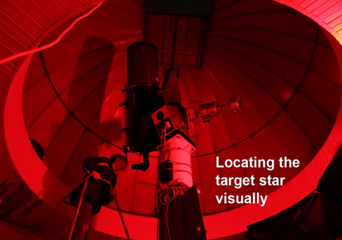
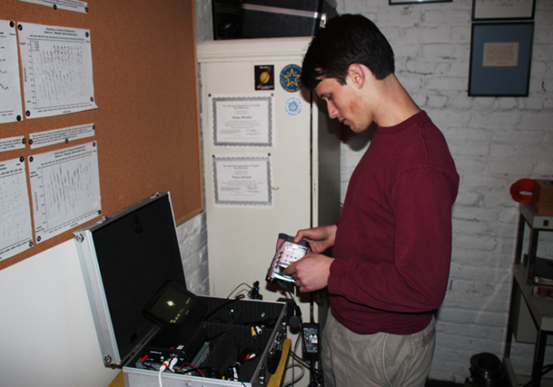
Winfree observatory
14” SCT
On Randolph College campus
Not used for other research

Slide 4
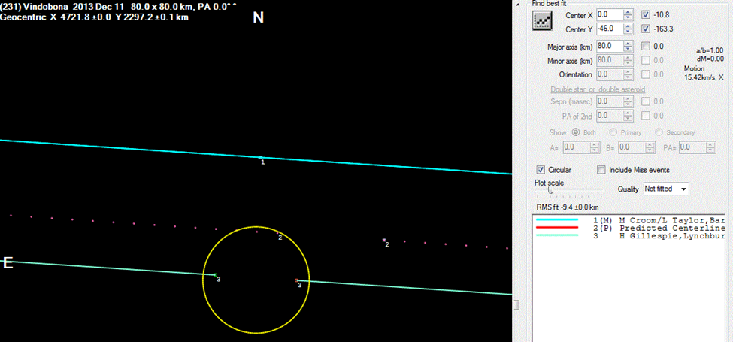
231 vindobona occultation
Clear skies, magnitude 10 star
One of only 3 Vindobona occultations observed

Slide 5
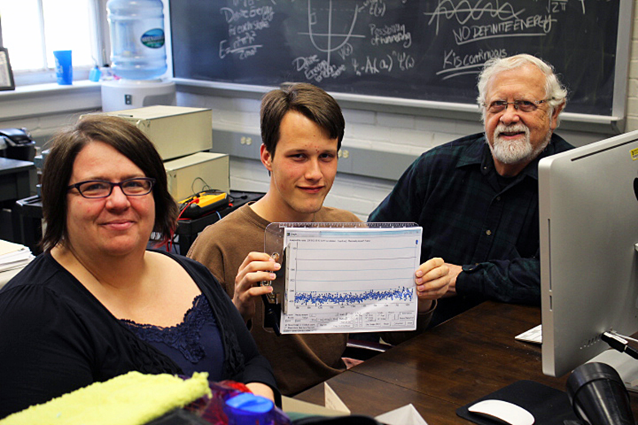
Other occultation attempts
1679 Nevanlinna
Success! 788 Hohensteina
211 Isolda with Steve Conard
Numerous others clouded out

Slide 6
Problems with asteroid occultation timing
Clouds
Light pollution
Data transfer
Poor telescope maintenance

Slide 7
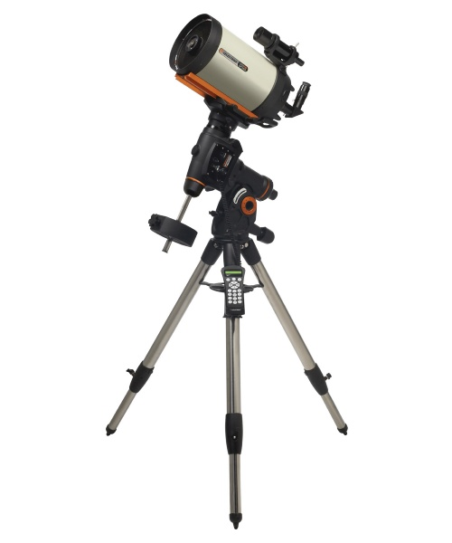
Potential solutions
Mobile observation capability
Camera with HDMI output or SD card slot

Slide 8
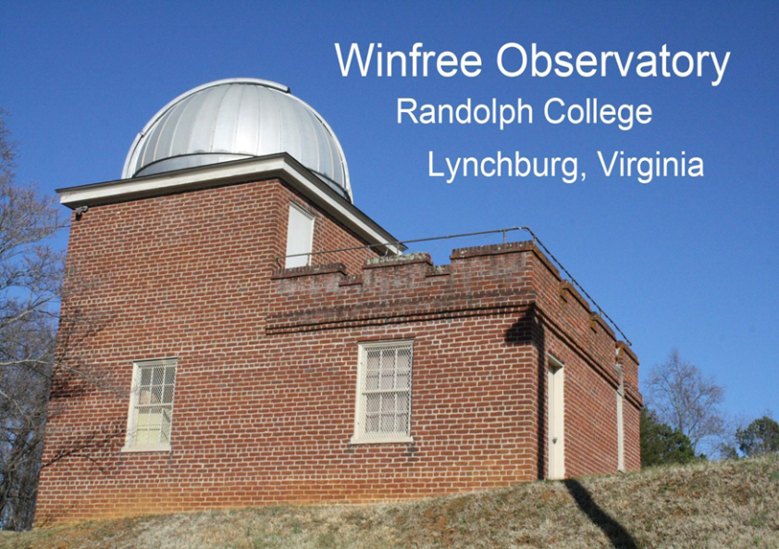
Extension to other colleges?
Effective tool for promoting both astronomical research and scientific inquiry
Low cost – mobile telescope (Celestron 6-inch SCTs $600-$1200), SCORE box ($500), and camcorder ($200) are all that is necessary
Promotes and enables astronomical research at the undergraduate level

Slide 9
acknowledgments
Steve Conard, IOTA
Blue Ridge Astronomy Club, sponsored by Randolph College Physics Department

